Slide 1


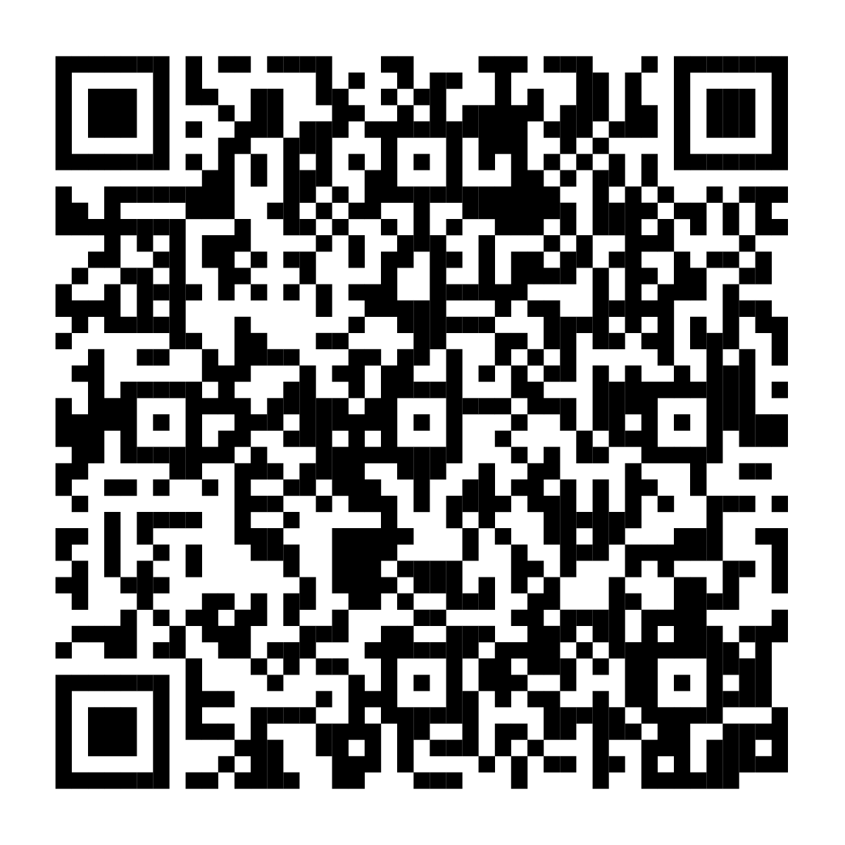
Build a future
that’s true to you
When it comes to money, everyone has unique needs.
That’s why we created a dedicated space just for you.
Find information that can help you feel more confident about saving, spending, and investing for the future.
Scan the code or visit
Fidelity.com/lgbtq
to learn more.
Investing involves risk, including risk of loss.
Fidelity and the Fidelity Investments logo are registered service marks of FMR LLC.
Fidelity Brokerage Services LLC, Member NYSE, SIPC, 900 Salem Street, Smithfield, RI 02917
© 2025 FMR LLC. All rights reserved. 1143859.3.0

